Slide 1
RCANN – A ReConfigurable Artificial Neural Network for Iris Flower Classification
Matthew Griessler and Nick Landy

Slide 2
Agenda
Change from Proposal
Application Description
Implementation Requirements
Implementation Design
Project Status
Testing Plan
Moving Forward

Slide 3
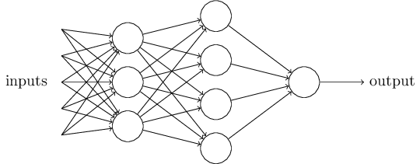
What is a Neural Network
Input Layer
Hidden Layer
Output Layer
Dataset | Input Layer | Hidden Layer | Output Layer
MNIST Handwriting | 784 | 15 | 10
Iris flower | 4 | 15 | 3

Slide 4
Changes from proposal
The MNIST design requires more MACs than available
We switched to a much simpler dataset, the iris data set
Implications of changing datasets
Structure: Same
Required resources: Decreases
Dataset | Input Layer | Hidden Layer | Output Layer
MNIST Handwriting | 784 | 15 | 10
Iris flower | 4 | 15 | 3

Slide 5
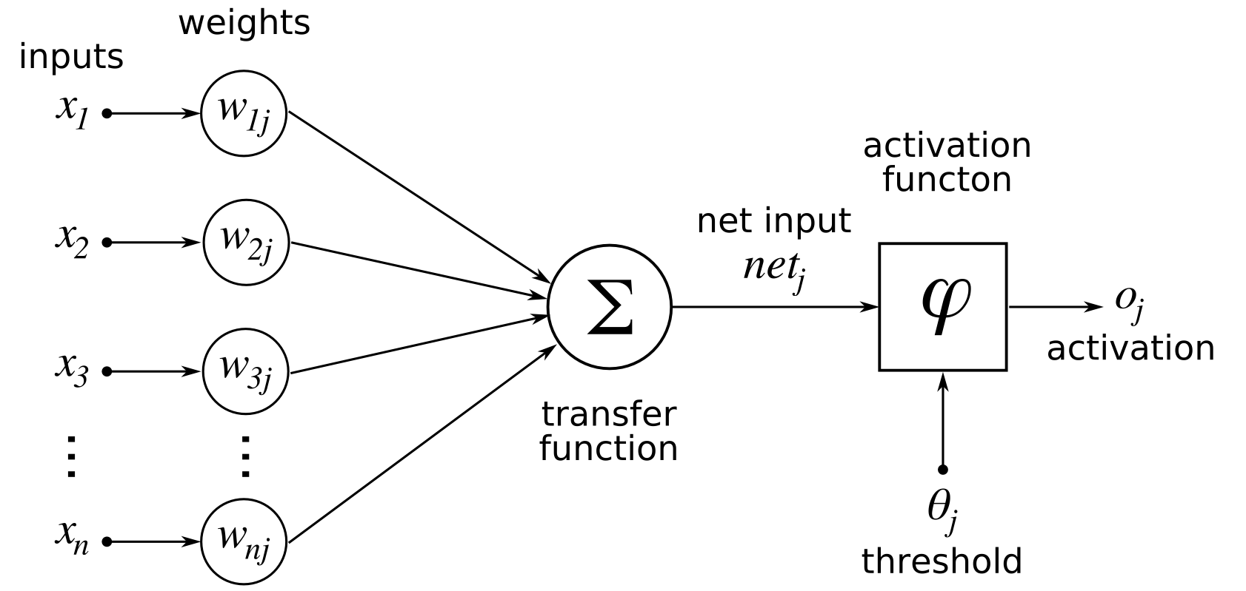
Neural Network - Node
It all starts with the node

Slide 6
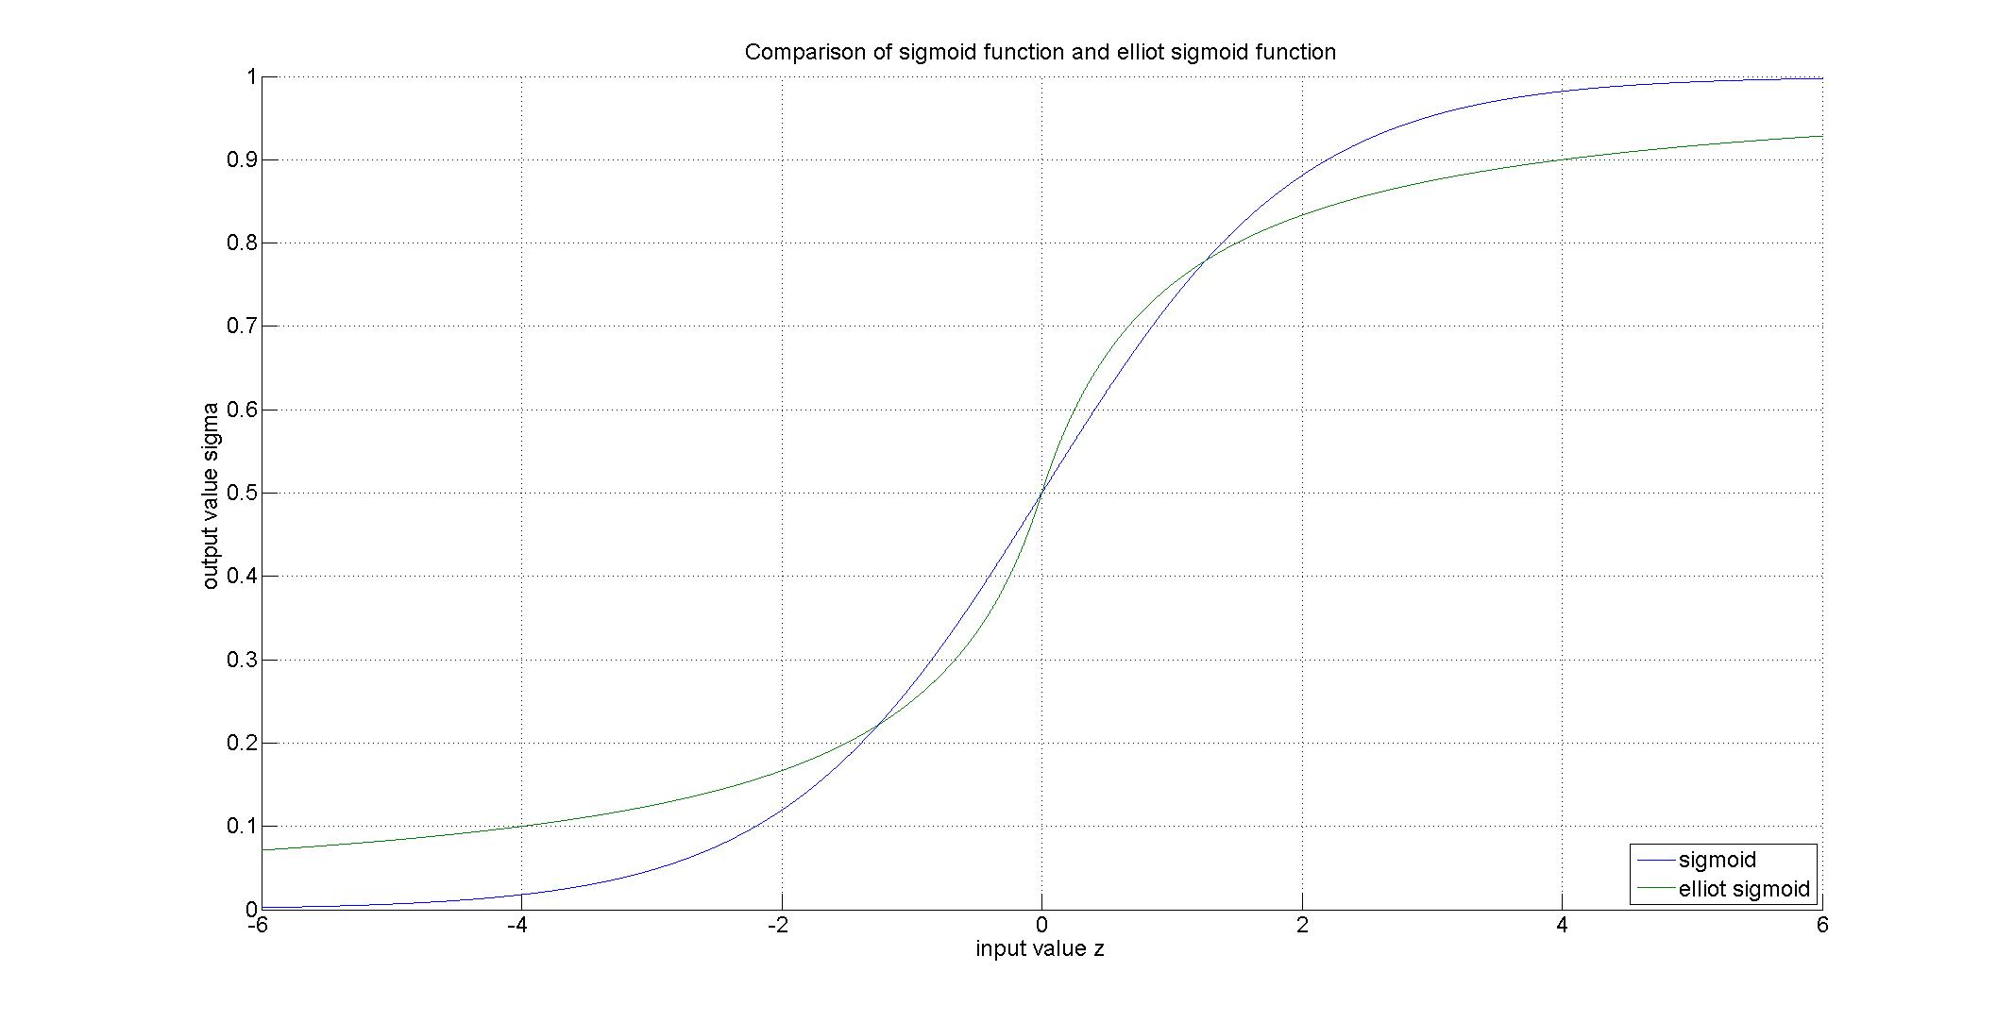



Neural Network – Activation Function
Sigmoid function
$$σ=\frac{1}{1+e^{−z}}$$
Elliot Sigmoid function
$$σ=\frac{1}{2}+\frac{z}{2(1+\left|z\right|)}$$
$$z=w∗x+b$$

Slide 7
Neural Network - Procedure
Neural network Use Procedure
Train for one epoch
Run verification
If performance is above threshold for accuracy (in our case 80%), go to step 4, otherwise, go back to step 1
Neural network is now ready for use with data where the answer isn’t known
Phase of Operation | Forward pass | Check Answer | Backpropagation
Training | Yes | Yes | Yes
Verification | Yes | No | No
Evaluation | Yes | No | No

Slide 8
Neural Network – Forward Pass
Process layers in order: first layer, hidden layer, output layer
Within a layer, nodes can be processed in parallel
Each node requires a multiply, accumulate, and activation function evaluation to get an output

Slide 9
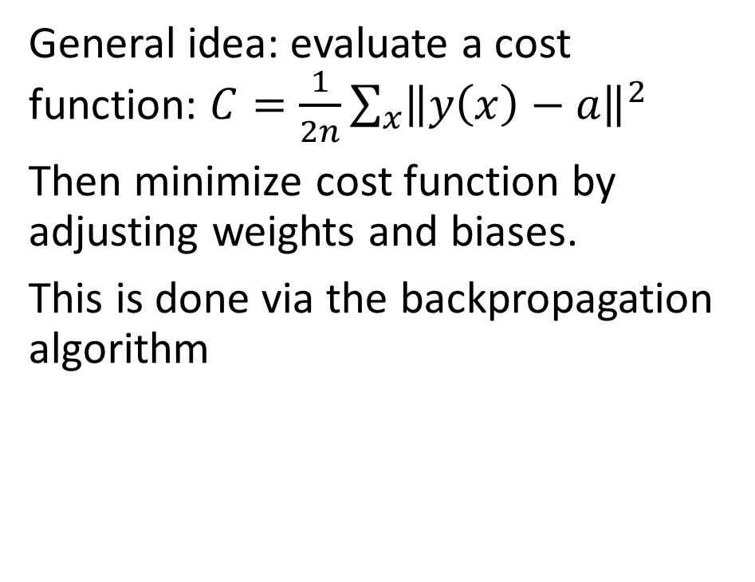
Neural Network - Backpropagation
General idea: evaluate a cost function: $C=\frac{1}{2n}\sum_{x}{{\left\|y\left(x\right)−a\right\|}^{2}}$
Then minimize cost function by adjusting weights and biases.
This is done via the backpropagation algorithm

Slide 10
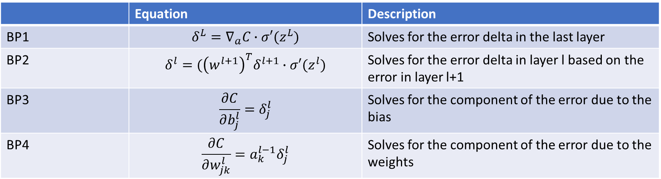
Neural Network - Backpropagation
 | Equation | Description
BP1 | $$δ^{L}=∇_{a}C∙σ′(z^{L})$$ | Solves for the error delta in the last layer
BP2 | $$δ^{l}=({\left(w^{l+1}\right)}^{T}δ^{l+1}∙σ′(z^{l})$$ | Solves for the error delta in layer l based on the error in layer l+1
BP3 | $$\frac{∂C}{∂b_{j}^{l}}=δ_{j}^{l}$$ | Solves for the component of the error due to the bias
BP4 | $$\frac{∂C}{∂w_{jk}^{l}}=a_{k}^{l−1}δ_{j}^{l}$$ | Solves for the component of the error due to the weights

Slide 11
Implementation Requirements
Req # | Requirement Description
General Requirements
G1 | Implement a neural network on an FPGA
G2 | Interface between FPGA and host computer
G3 | Demonstrate a speedup from implementation
G4 | Support training, verification, and evaluation
G5 | Support epoch and batch processing
Neural Network Requirements
N1 | Three layer network
N2 | Each layer can be configured with generic number of nodes
N3 | Implement forward pass, verification, and backpropagation
Forward Pass Requirements
F1 | Support pipe-lined and non-pipelined operation
F2 | Implement Elliot Sigmoid function for activation function
F3 | Take input from double buffered input memory
F4 | Put output into double buffered output memory
Verification Requirements
V1 | Check output against expected answer stored in double buffered memory
Backpropagation Requirements
B1 | Implement backpropagation equation BP1
B2 | Implement backpropagation equation BP2
B3 | Implement backpropagation equation BP3
B4 | Implement backpropagation equation BP4
B5 | Update node layer-layer weights
B6 | Update node biases

Slide 12
Implementation Design

Slide 13
Project Status

Slide 14
Testing Plan

Slide 15
Moving Forward

